Slide 1

Games Strategic on The App Store

Slide 2
AGENDA
01
02
03
04
Tolls
Preprocessing
Future Work
Intruduction

Slide 3
Intruduction
The Mobile Games 'is worth billions of dollars, with companies spending vast amounts of money on the development and marketing of these games to an equally large market. Using this data set, insights can be gained into a sub-market of this market, strategy games.

Slide 4
TOOLS
Jupyter
Python
NumPy
Pandas
Seaborn
Matplotlib

Slide 5
DATA STRUCTURE
Preprocessing
DATA CLEANING
DATA ANALYSIS

Slide 6
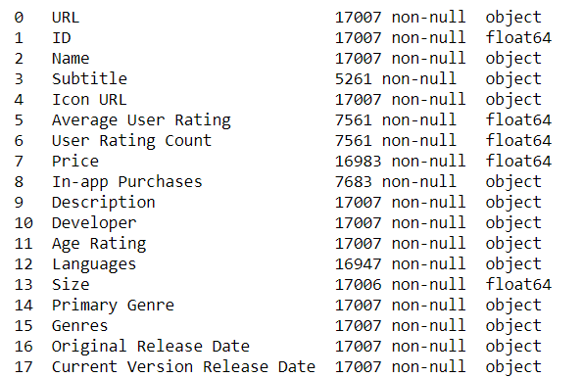
DATA STRUCTURE
Reading the data for the data from 2010 to 2019 ,
18 Columns, 17007 Row.

Slide 7
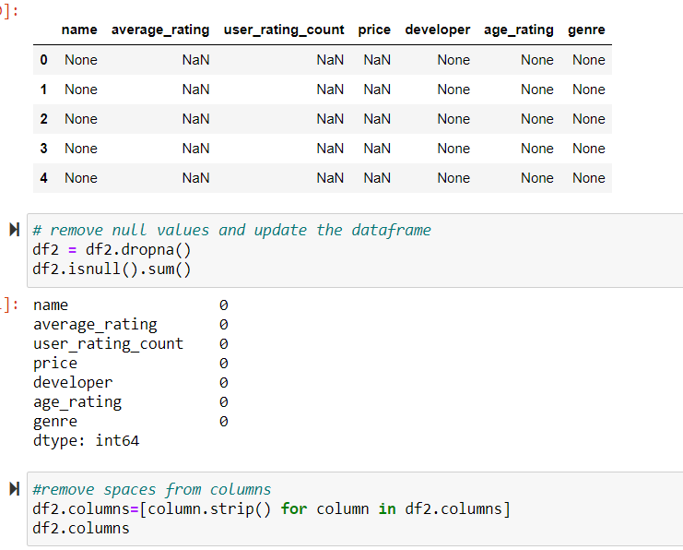
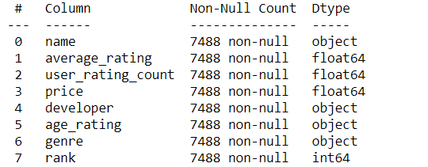
DATA CLEANING
removing null values
Check duplicates, spaces between word
redefined columns name for better usages
column split years

Slide 8
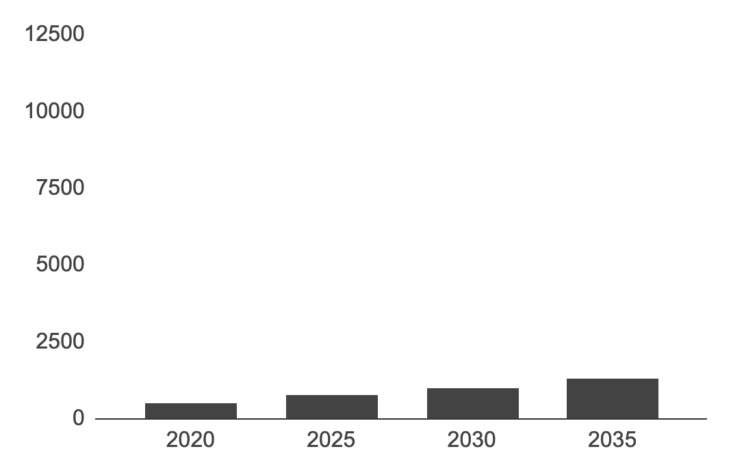
DATA ANALYSIS

Slide 9
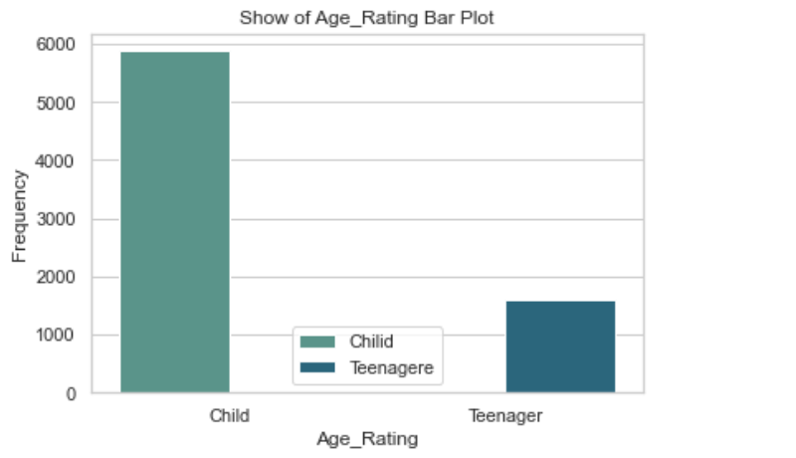
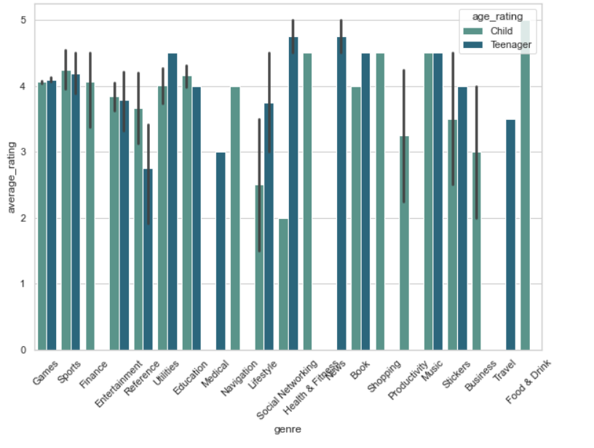
DATA ANALYSIS
Strategic 1
LET US SEE WHO USE THE GAME APPS MORE CHILDREN OR TEENEGERS

Slide 10
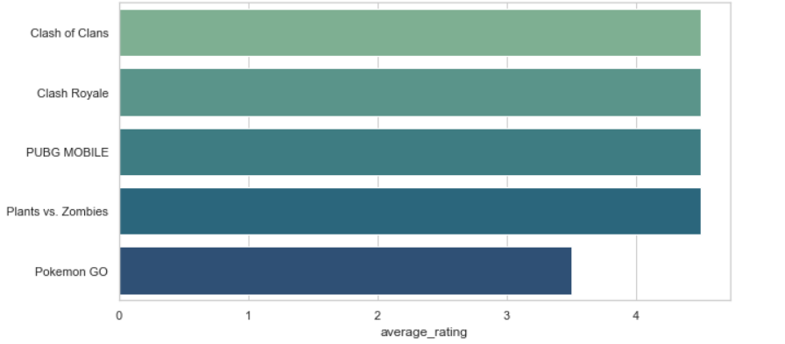



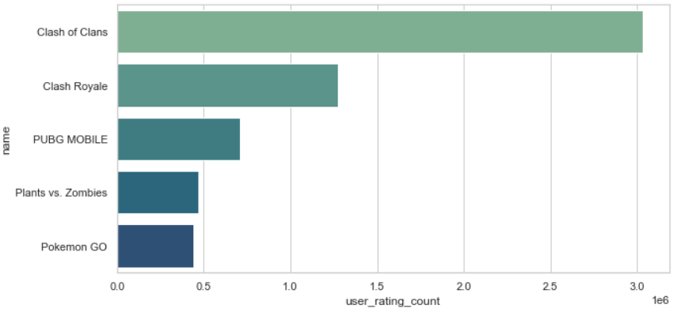

DATA ANALYSIS

Slide 11
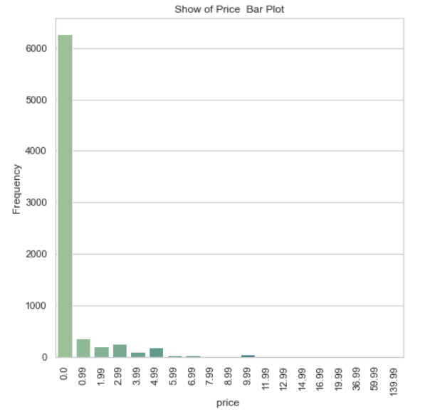
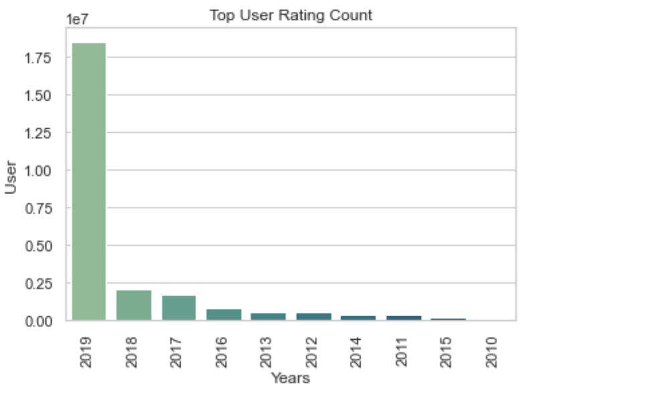
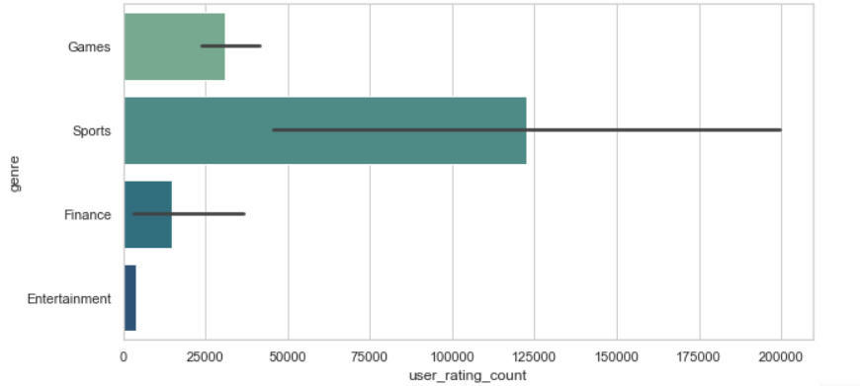
DATA ANALYSIS

Slide 12
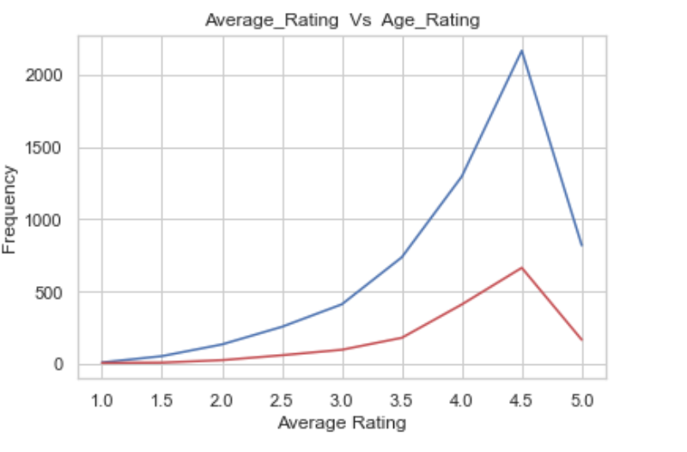
DATA ANALYSIS

Slide 13
GAME
OVER

Slide 14
LOCATIONS
SAUDI ARABIA

